Slide 1
NBA Data
By: Andrew Ouyang and Jesse Tan

Slide 2
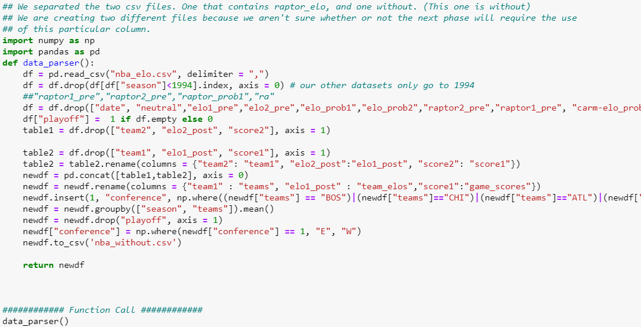
Cleaning our data - NBA Elo
We used a csv file that had elo data along with other information and removed extraneous columns. We also removed rows that were not within our range and added a new column to display each team’s conference.

Slide 3
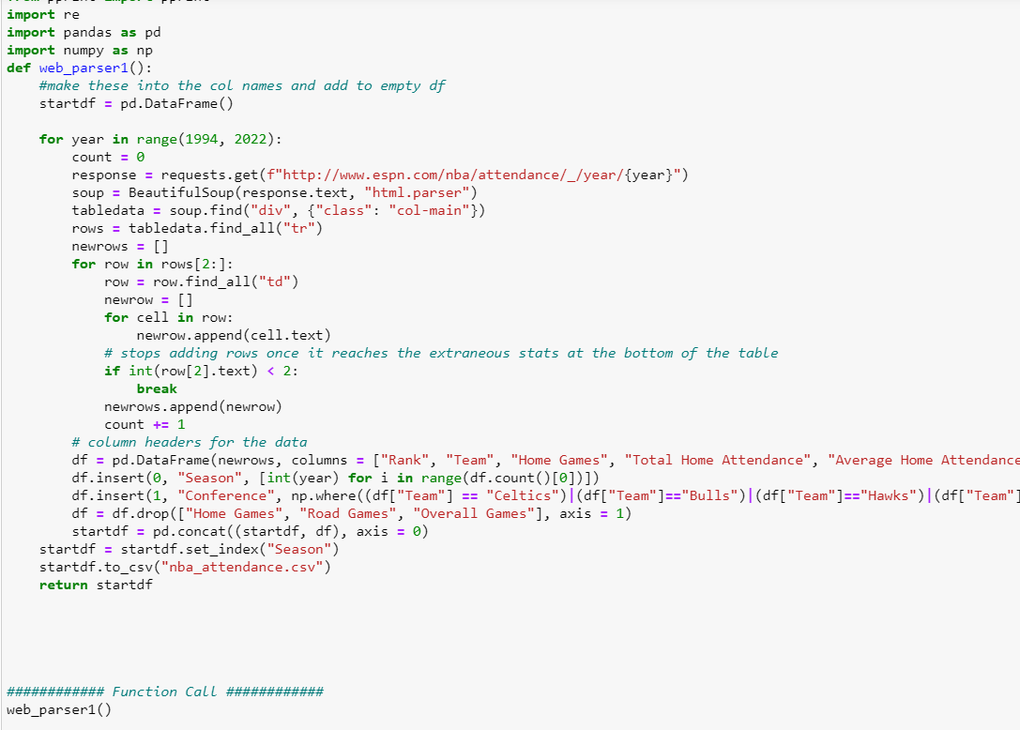
Cleaning our data - NBA Attendance
We used BeautifulSoup to parse the html file for attendance data for NBA seasons. We iterated through each season and parsed that season’s specific website. We also renamed most of the columns and added a conference column for the teams.

Slide 4
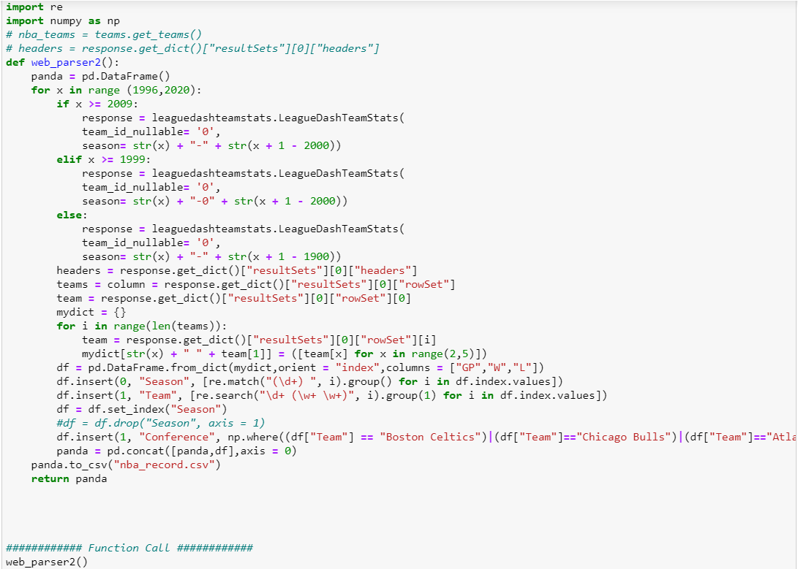
Cleaning our data - NBA Wins
The data that we had included many columns that we ultimately got rid of because they weren’t relevant to our hypothesis, so we got rid of them.
We used regex to match the correct information gathered from the API.

Slide 5
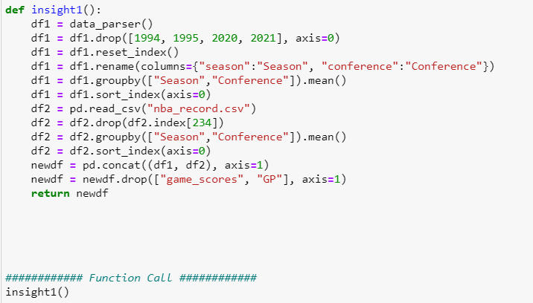
Comparing Eastern vs Western Elos and Wins/Losses
Someone may be interested in comparing the performance of the Eastern vs. Western conferences for each season using both the elo metric from our data parser and wins and losses from web parser 2. These two measures of performance should be correlated but may not be exactly the same so using both may give more insight into the performance of each conference. It would make sense for someone to be interested in finding out which conference is better overall.

Slide 6
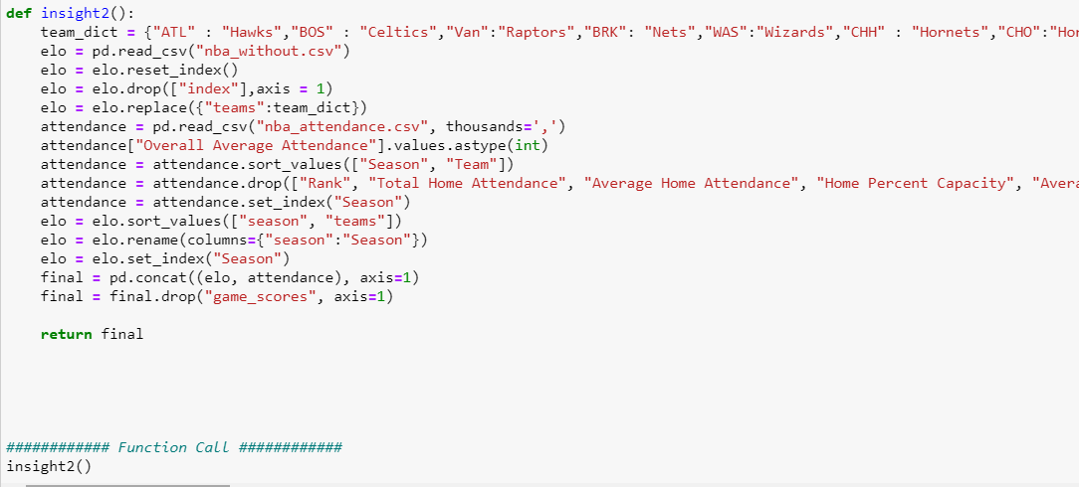
Comparing Team Elos and Overall Average Attendance
Someone may be curious about how good a team is (their elo) and how many people attend each game per season. We will combine the attendance and elo table to see the effect of increasing elo and attendance to see if there is a correlation. It would be reasonable to expect that better teams have higher attendance and this insight would show wheter or not that is true.

Slide 7
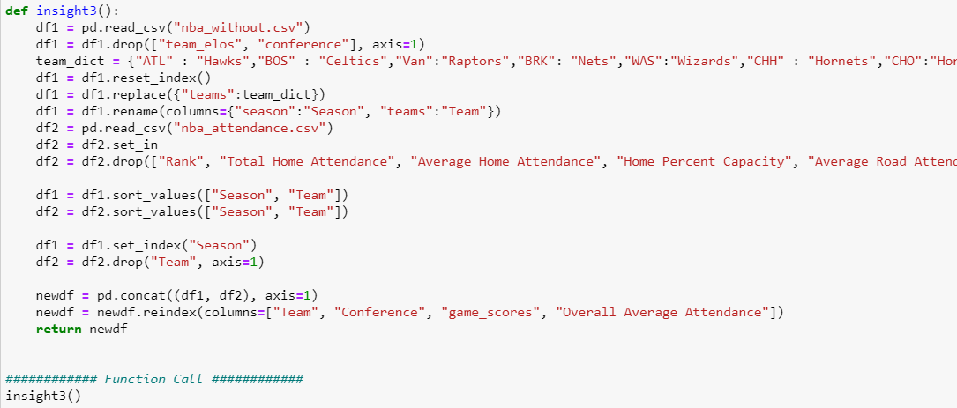
Comparing Game Scores and Overall Average Attendance
Since elo is based off of wins and losses, this insight will allow someone to calculate eastern vs. western elo to see which conference has been stronger throughout the years in terms of their respective wins and losses. This would be able to be compared to the insight 1 table where elos are compared between conferences. The elo calculation in insight 1 are based off of past seasons as well as the current season. However, this insight can be used to determine seasonal elos rather than elos across years.

Slide 8
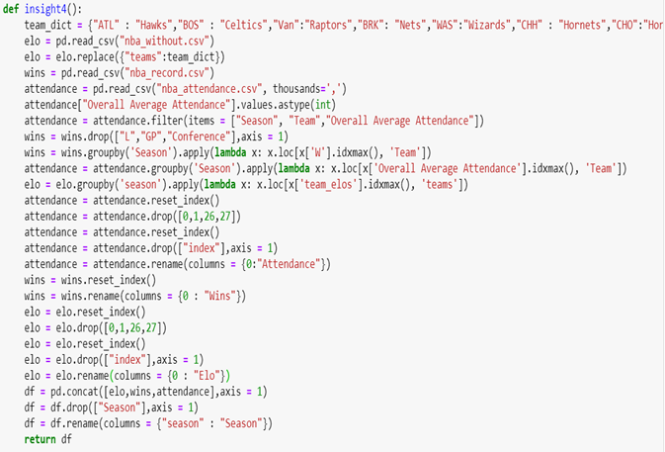
Comparing (highest) ELO, Wins, and Attendance
Someone might want to know which team performed "best" for each season in each of our datasets. This insight finds the highest eloed team compared for each season to the highest win team for each season and also compared to the highest attendance team for each season. This is reasonable because one metric may be correlated with the other metrics but teams might perform different than expected.

Slide 9
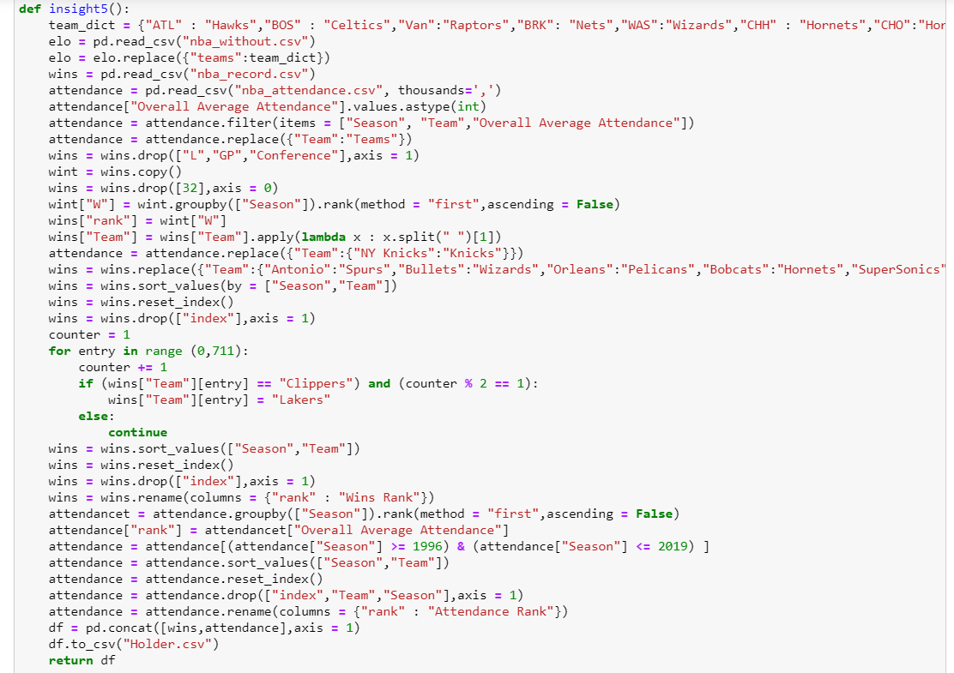
Comparing Rankings of Wins to Attendance
This insight allows the user to compare each team's Wins and their respective wins ranking to their overall average ranking and their respective attendance ranking. This would be useful to see if a particular team's wins rank is correlated to their attendance rank. This data shows that there isn't that much correlation between the two. The attendance for some teams may be skewed because a team that was good the prior season but was impacted by injuries may play poorly but still have high attendance.

Slide 10
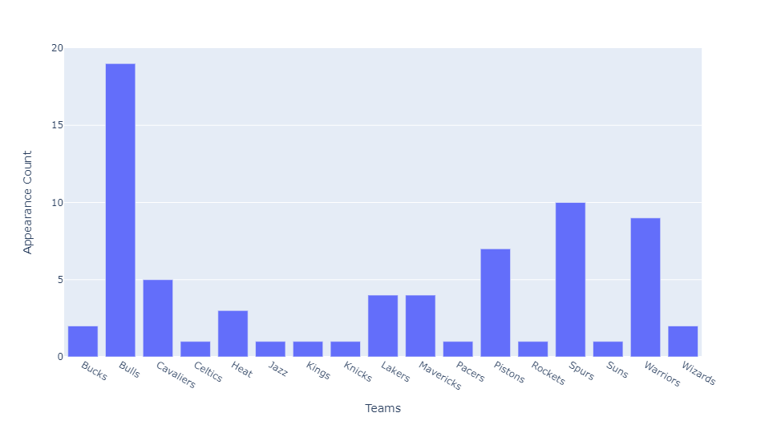
Visualization 1
We made this visualization to see how often a particular team would be ranked number 1 in elo, wins, or highest overall attendance. From this data we can see that almost half the teams were not ranked top one in the past twenty five years. These graph shows which teams perform the best based off of our metrics.

Slide 11
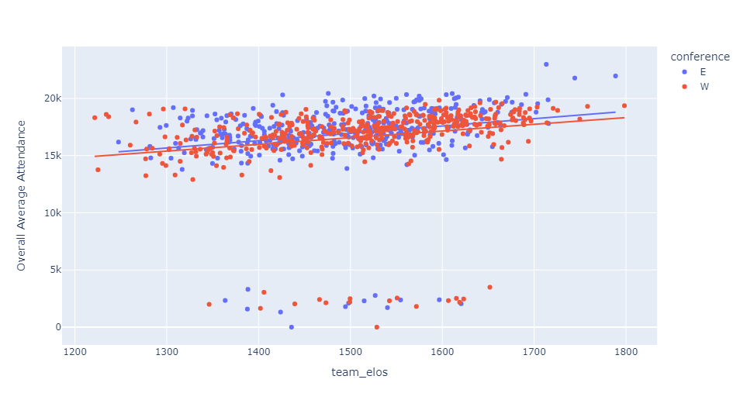
Visualization 2
This visualization shows a trend that there is not much correlation between how well a team does (team_elos), and their overall average attendance. This is partly due to the fact that some teams are more popular even if they're not playing well, i.e. the Knicks, and larger markets having more popularity than the smaller markets. We also have some outlier points at the bottom of the graph because in the Covid Season, most of the teams hardly had any fans attending their games, if even.

Slide 12
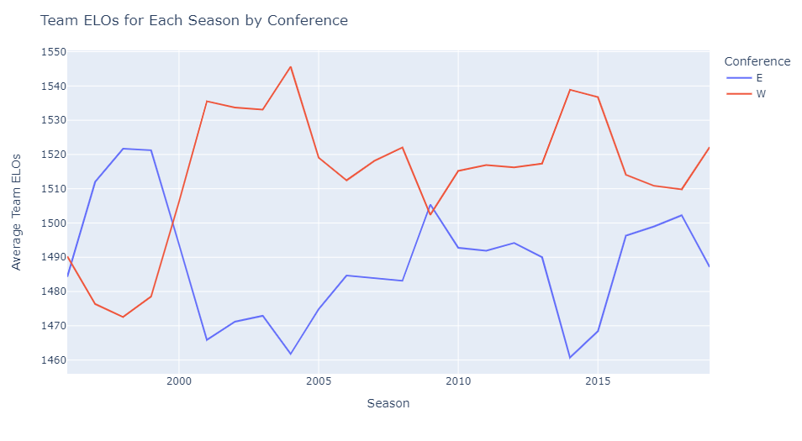
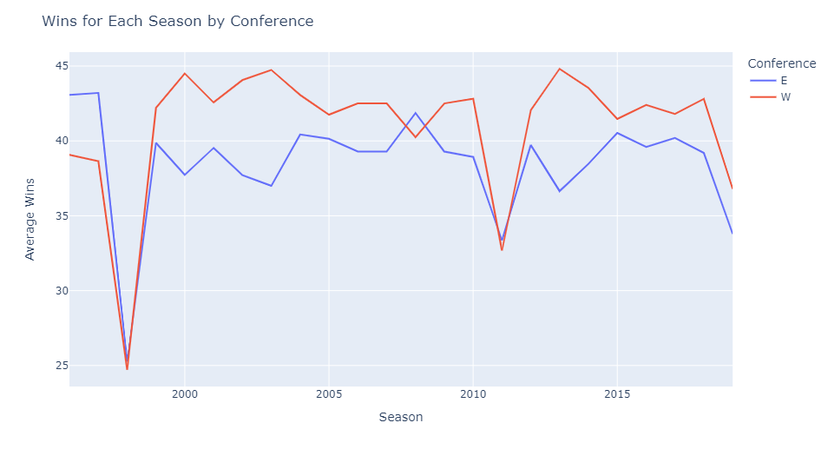
Visualization 3
This visualization shows a side by side comparison of the average calculated elo for each conference over the seasons and of the average wins for each conference over the seasons. These line graphs show that the Eastern conference performs better for the earlier years than the Western conference, but the West seems to have performed better for both metrics for most other seasons. Both plots show similar patterns but are still very different.

Slide 13
Issues we had with our data
The data we scraped and cleaned were from three different sources, which meant that the way the sources presented the data to us weren’t the same. We had to do a lot of dictionary matching and renaming to get the same format with each file. The way the attendance data was represented was different from the wins data, where the attendance had all the modern names of teams all changed, but the wins had team names of that particular year, which we had to go back and find and change to that of the modern one.
Our large data set had a lot of null values for different columns.

Slide 14
Conclusion
This project gave us a lot of insight into the whole process behind finding a dataset, cleaning it, and finding correlations between our data. Overall, we found that our datasets didn’t have much correlation with one another.

